Slide 1
Calculation of Basketball Scoring Probabilities
Data Scientist: [Waseem Almazrua]
© 2024 Udacity.

Slide 2
Agenda
Results of basketball scoring calculations
Overall Shooting Statistics
Probabilities
Conditional Probabilities - Future
Conditional Probabilities - Retrospective

Slide 3
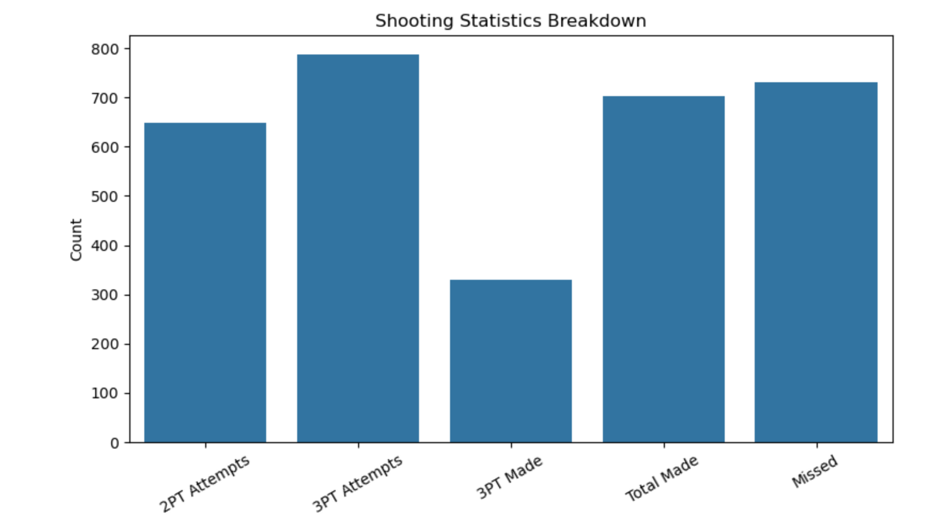
Overall Shooting Statistics
• Total Shots: 1434
• Made Shots: 703
• Missed Shots: 731
• 2-Point Attempts: 648
• 3-Point Attempts: 786
• 3-Point Made: 329
• Overall Shooting Accuracy: 49.02%
### “Steph Curry attempted more 3-point shots than 2-point shots in this dataset, but his overall accuracy was below 50%.

Slide 4
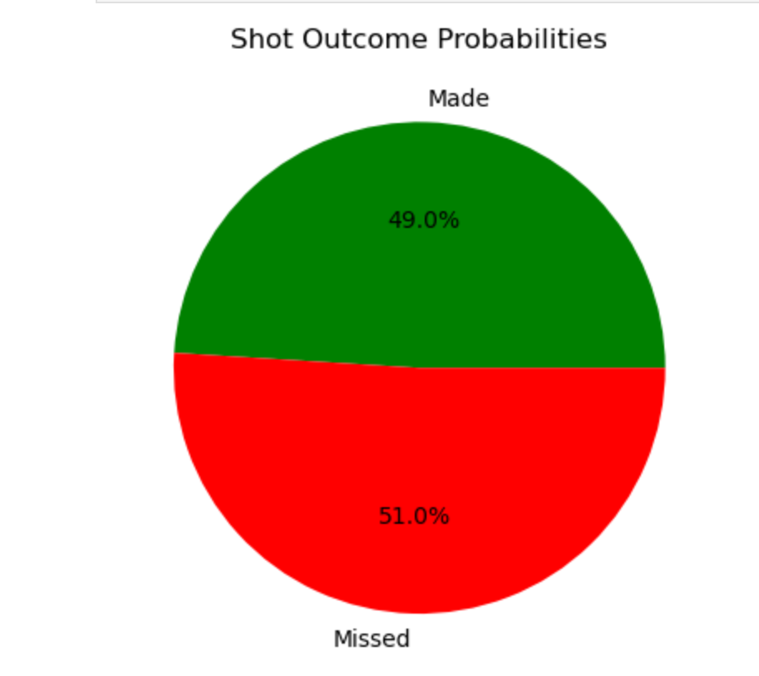
Probabilities
• P(Made) = 0.49
• P(Missed) = 0.51
• P(3PT) = 0.55
• P(Made | 3PT) = 0.42
• P(Made ∩ 3PT) = 0.23
"Steph Curry attempted more 3-point shots than 2-point shots. However, his success rate for 3-point shots is around 42%."

Slide 5
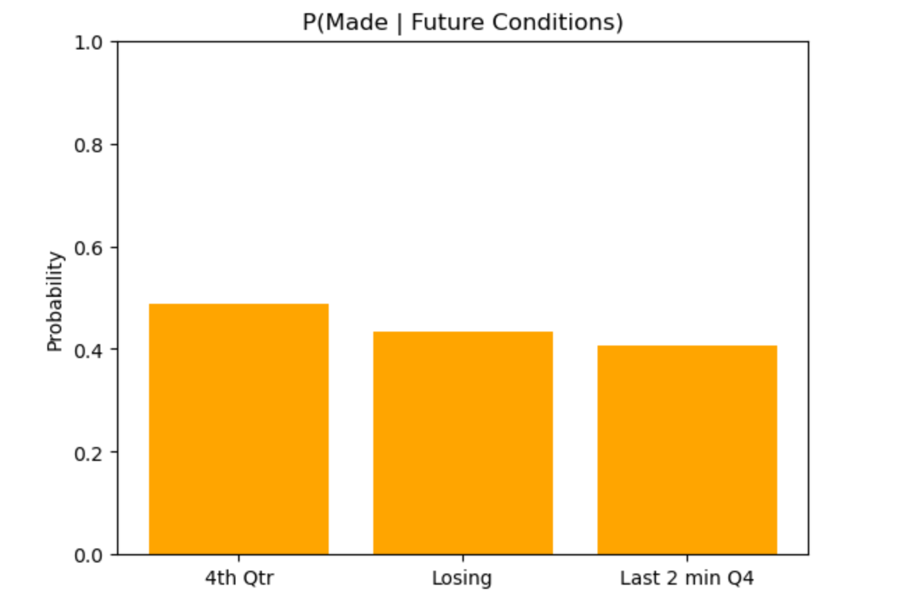
Conditional Probabilities - Future
• P(Made | 4th Qtr) = 0.49
• P(Made | Losing) = 0.43
• P(Made | Last 2 min of 4th Qtr) = 0.41
"Steph Curry’s shot success rate slightly drops in critical game moments, such as the last 2 minutes of the 4th quarter or when trailing."

Slide 6
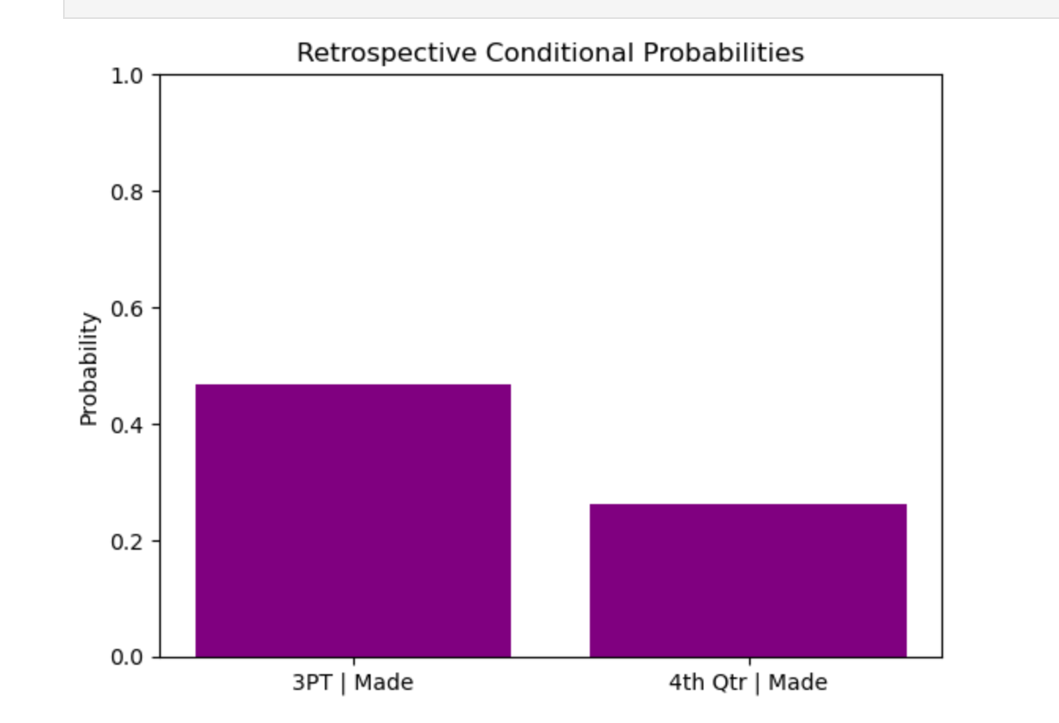
Conditional Probabilities - Retrospective
• P(3PT | Made) = 0.47
• P(4th Qtr | Made) = 0.26
"Roughly 47% of Curry’s made shots were 3-pointers, and 26% occurred in the 4th quarter. This highlights his preference for long-range shots even in pressure moments."

